Slide 1
Lecture 2
Unit 1

Slide 2
Improving corporate ethics
Assume one scenario, you want to start a company (any company) what type of rules you will going to make for your employee.

Slide 3
Improving corporate ethics
Ethics Resource Centre found
Attended Ethical workshop | NOT attended ethical workshop
86% of them are perceiving strong ethical culture | 25% of them are perceive a culture that promote integrity

Slide 4
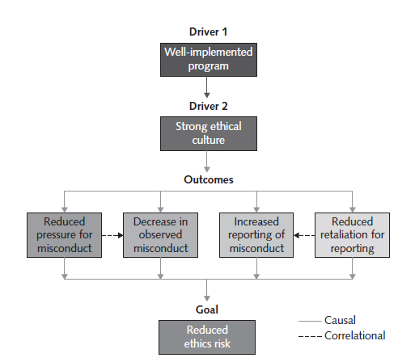

Slide 5
Characteristics of a successful ethics program
Employees are willing to seek advice about ethics issues.
• Employees feel prepared to handle situations that could lead to misconduct.
• Employees are rewarded for ethical behaviour.
• The organization does not reward success obtained through questionable means.
• Employees feel positively about their company.

Slide 6
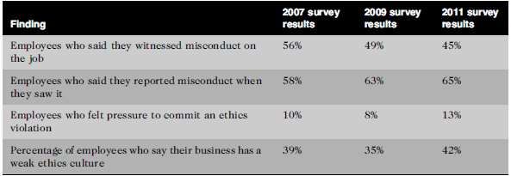
Survey after completion of workshop
National business survey

Slide 7
How can we improve business ethics ?
Appointing a Corporate Ethics Officer
A corporate ethics officer (also called a corporate compliance officer) provides an organization with vision and leadership in the area of business conduct.
the corporate ethics officer should be a well-respected, senior-level manager who reports directly to the CEO.
Ethics officers come from diverse backgrounds, such as legal staff, human resources, finance, auditing, security, or line operations.

Slide 8
Need of appointing CEO
Started in 1980 when series of defence-contracting scandals when firms used bribes to gain inside information that they could use to improve their contract bids.
increase in appointments followed in the aftermath of the mortgage loan scandals uncovered beginning in 2008.

Slide 9
Specific responsibilities include the following:
Responsibility for compliance—that is, ensuring that ethical procedures are put into place and consistently adhered to throughout the organization
Responsibility for creating and maintaining the ethics culture that the highest level of corporate authority wishes to have
Responsibility for being a key knowledge and contact person on issues relating to corporate ethics and principles

Slide 10
Ethical Standards Set by Board of Directors
responsible for careful and responsible management of an organization.
In a for-profit organization, primary objective is to oversee the organization’s business activities and management for the benefit of all stakeholders
A board of directors fulfils some of its responsibilities directly and assigns others to various committees. The board is not normally responsible for day-to-day management and operations
However, the board is responsible for supervising the management team. Board members responsibilities are :-
set highest standard for personal and professional integrity
ethical conduct
compliance with laws and regulations.

Slide 11
News Corporation is a media conglomerate founded by Rupert Murdoch—with recent annual revenue over $30 billion generated by its cable networks (including Fox News Channel), film and television production subsidiaries, and publishing units. In 2009, it came to light that News Corporation’s British subsidiary, News International Ltd., publisher of the highly popular Sunday tabloid paper, News of the World, used telephone hacking and bribes to police to obtain stories about celebrities, sports figures, politicians, and ordinary citizen’s. It was alleged that the practice was well known to senior executives within the company. Based on strong negative public reaction, News Corporation stopped publication of the News of the World tabloid, and the British government blocked a major deal in which News Corporation was to fully acquire the highly successful British broadcasting company BskyB. These actions resulted in a $3 billion drop in the stock value of News Corporation. In addition, the scandal led to the arrest of over 60 former and current journalists, and many high-level executives resigned from the firm. In a lawsuit filed in March 2011, shareholders claimed lack of board oversight for failing to react to warning signals that should have alerted them to the telephone hacking.

Slide 12
Establishing a Corporate Code of Ethics
A code of conduct defines how a company’s employees should act on a day-to-day basis.
It reflects the organization’s daily operations, core values and overall company culture
every code of conduct is unique to the organization it represents.

Slide 13
Sarbanes–Oxley Act of 2002
Enron's complex financial statements were confusing to shareholders and analysts. In addition, its complex business model and unethical practices required that the company use accounting limitations to misrepresent earnings and modify the balance sheet to indicate favourable performance The combination of these issues later resulted in the bankruptcy of the company

Slide 14
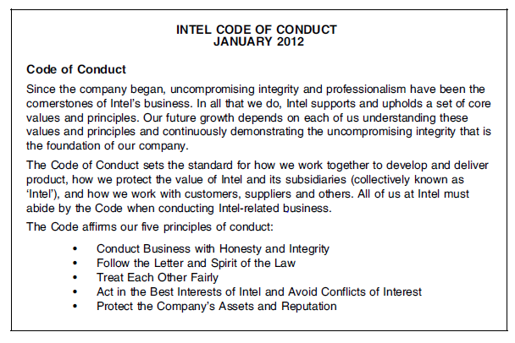

Slide 15
Conducting Social Audits
conduct regular social audits of their policies and practices.
In a social audit, an organization reviews how well it is meeting its ethical and social responsibility goals, and communicates its new goals for the upcoming year.

Slide 16
Intel CSR report 2011
Each year Intel prepares its “Corporate Responsibility Report,” In 2011,Intel focused on goals in three primary areas:
(1) the environment—with targets set for global-warming emissions, energy consumption, water use, chemical and solid waste reduction, and product energy efficiency
(2) corporate governance—with goals to improve transparency and strengthen ethics and compliance reporting
(3) social—with goals to improve the organizational health of the company as measured by its own Organizational Health Survey, to expand the number of supplier audits, and to increase the number of community education programs

Slide 17
Requiring Employees to Take Ethics Training
The ancient Greek philosophers believed that personal convictions about right and wrong behaviour could be improved through education.
organization’s code of ethics must be promoted and continually communicated within the organization, from top to bottom.

Slide 18
Motorola, designer of wireless network equipment, cell phones, and smartphones, is committed to a strong corporate ethics training program to ensure that its employees conduct its business with integrity. The focus of the training is to clarify corporate values and policies and to encourage employees to report ethical concerns via numerous reporting channels. Motorola investigates all allegations of ethical misconduct, and it will take appropriate disciplinary actions if a claim is proven—up to and including dismissal of all involved employees. All salaried employees must complete an online introduction to the ethics program every three years. All managers in newly acquired businesses or high-risk locations must take further classroom ethics training. Motorola operates a 24-hour toll-free service for reporting any suspected ethical concerns. In 2011, the firm introduced a Code of Business Conduct in 10 languages and updated its suite of ethics training courses to include new anticorruption and anti bribery training

Slide 19
Including Ethical Criteria in Employee Appraisals
Performance
Self improvement
Successful completion of projects
Initiatives
Maintenance of good customer relation

